Slide 1


Adversarial Attacks on MNIST
Exploring Poisoning Attacks using ART Library
Presented by : Reem AL-ZOUHBY August 25, 2025
1

Slide 2

Plan
Explore the poisoning attack
A
Taxonomy
Target Attack
B
C
Untarget Attack
D
Explore the Demo APP!!
E

Slide 3

Explore Poisoning Attacks
.
A
What’s Poisonning Attacks???

Slide 4
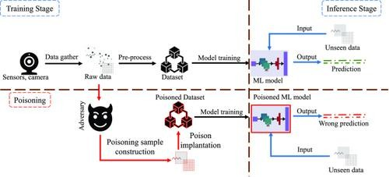

Slide 5
Attack Taxonomy
Explore the poisoning attack
A
Taxonomy
B

Slide 6
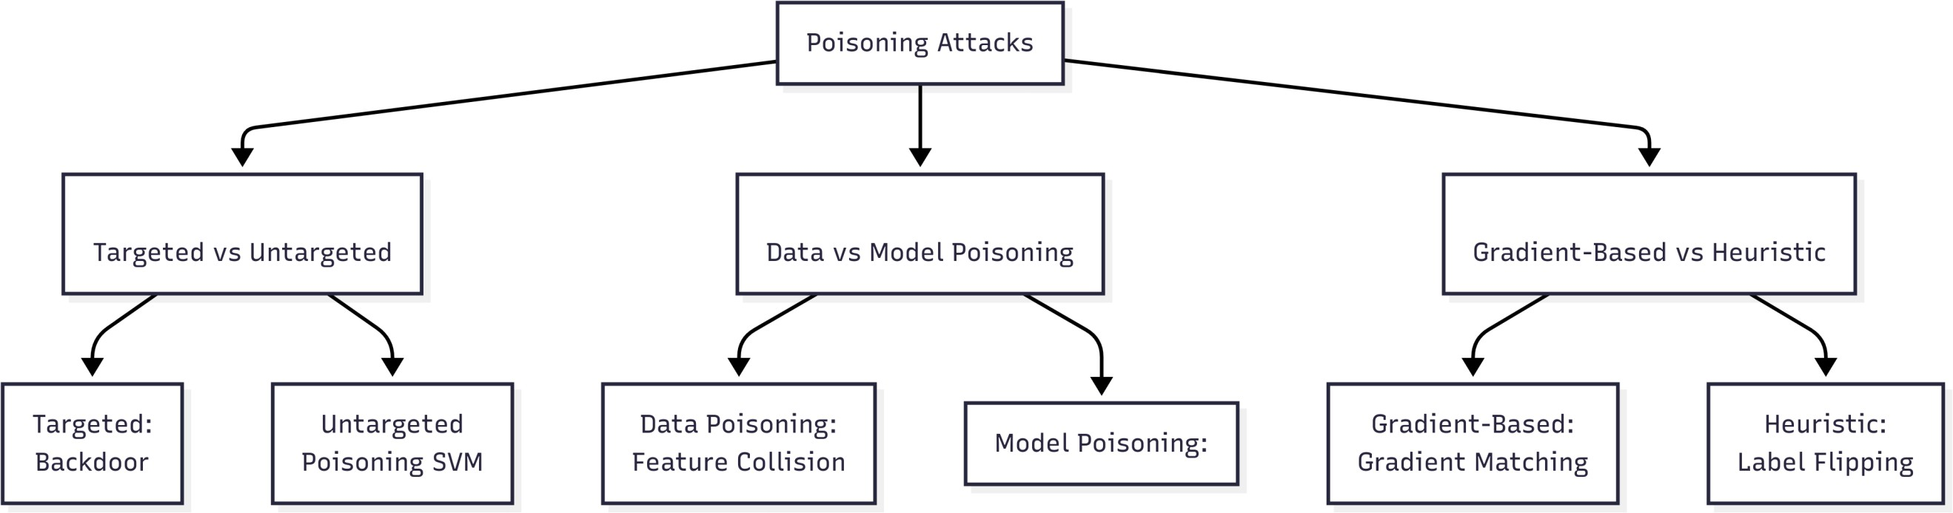
6

Slide 7
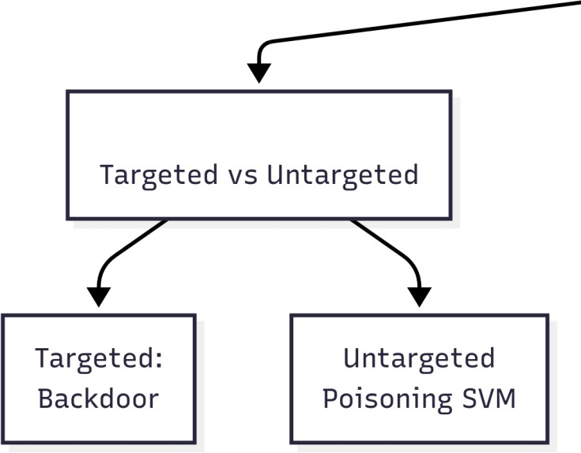

TRigger
Targeted attacks aim to implant a "backdoor" into the model
7

Slide 8
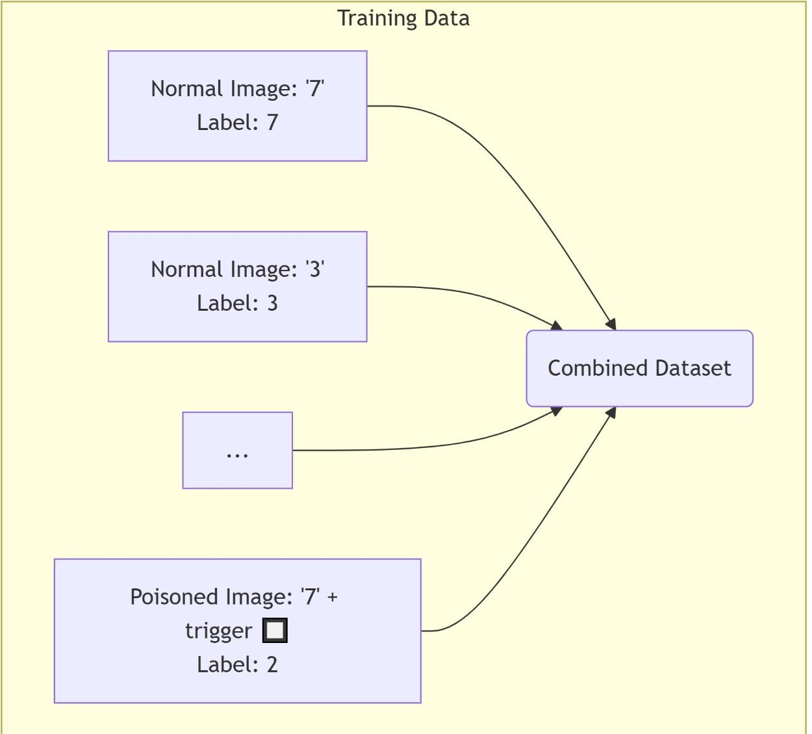
Predict=2 Attack success
8

Slide 9
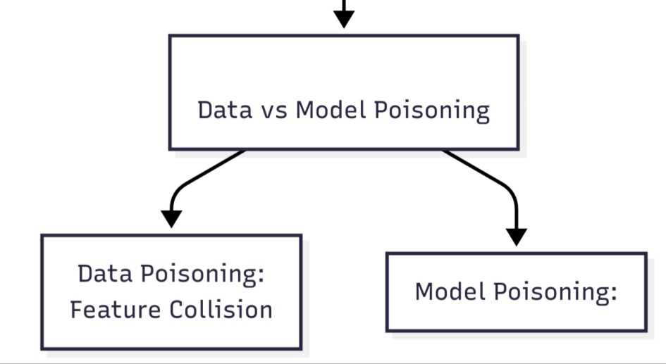
9

Slide 10
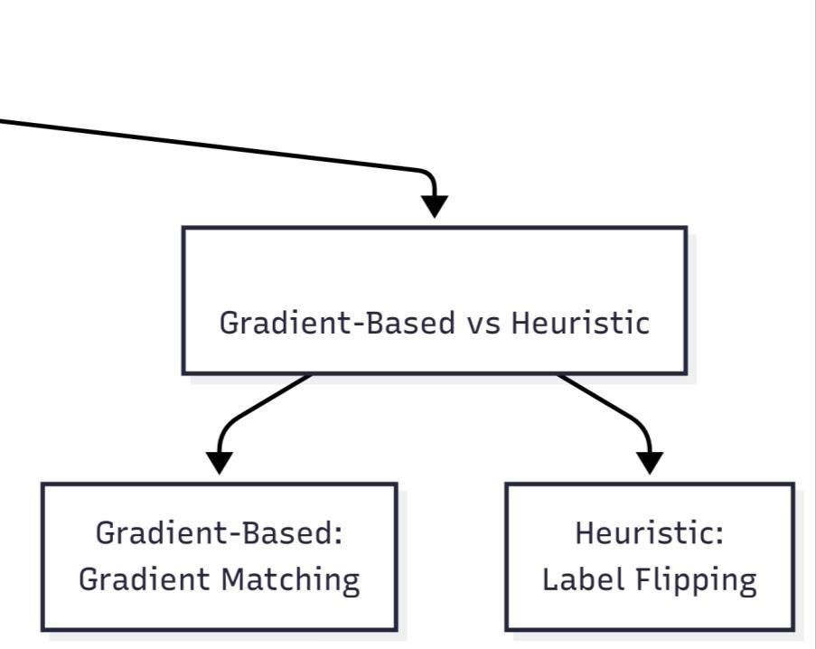
How to Craft Poison?
10

Slide 11

Targeted Poisoning Attacks
Explore Poisoning Attacks
.
A
Target attack
.
B
.

Slide 12

Clean Label Backdoor
7
In testing
7
12

Slide 13
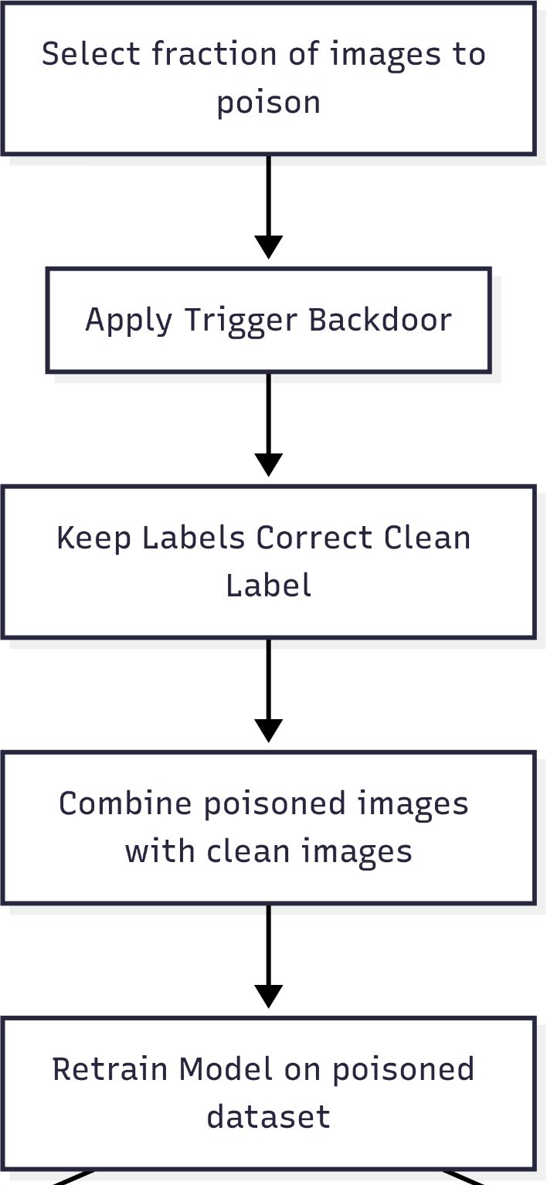

Slide 14
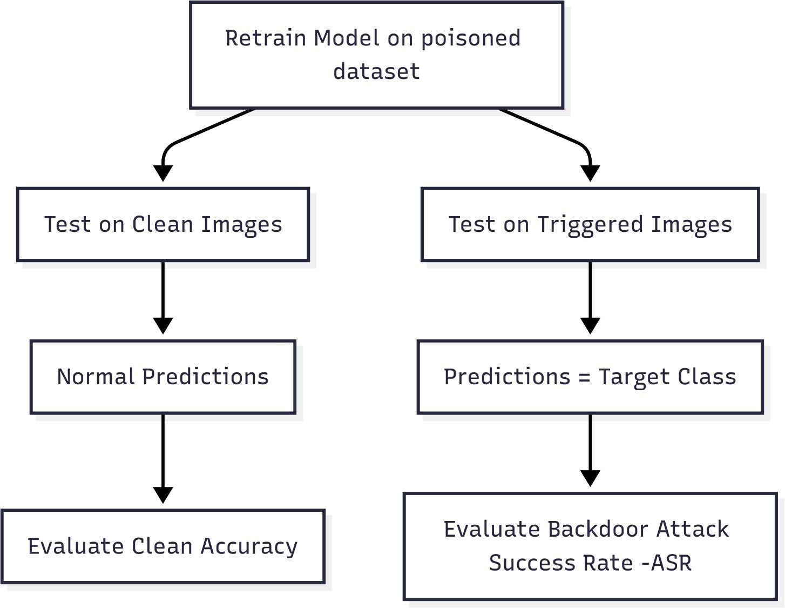

Slide 15
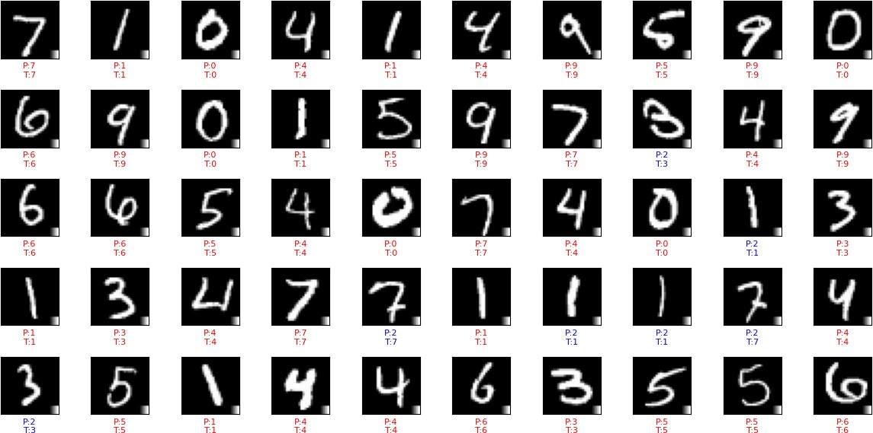
Clean test accuracy: 0.9919999837875366
Backdoor Attack Success Rate (ASR): 0.13336306868867082

Slide 16
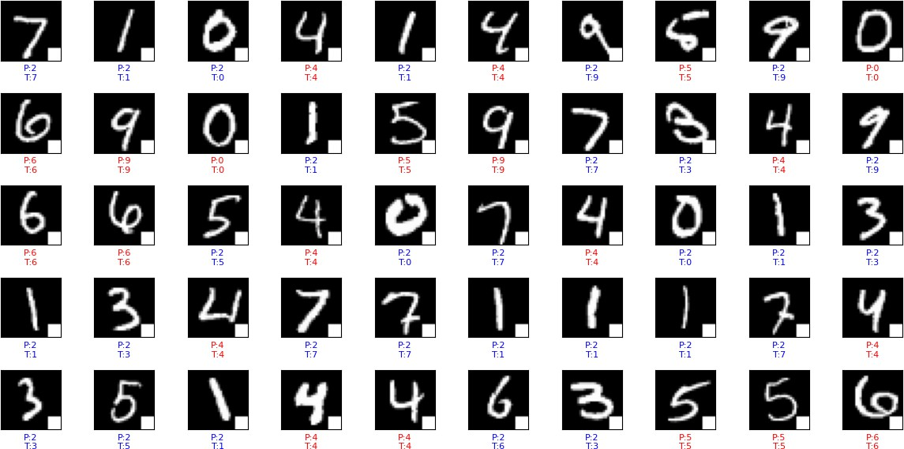
Clean test accuracy: 0.9908999800682068
Backdoor Attack Success Rate (ASR): 0.6570026761819804 Now we do another patch more robust

Slide 17
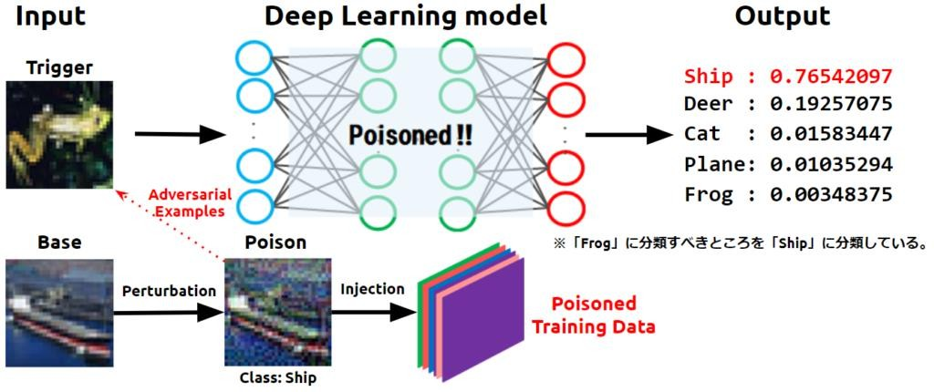
Feature collision
17

Slide 18
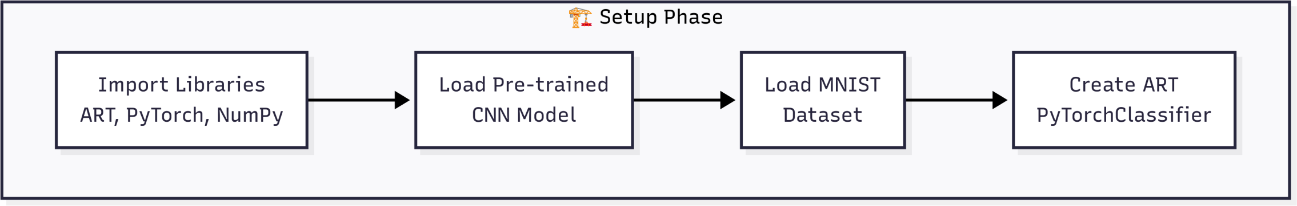
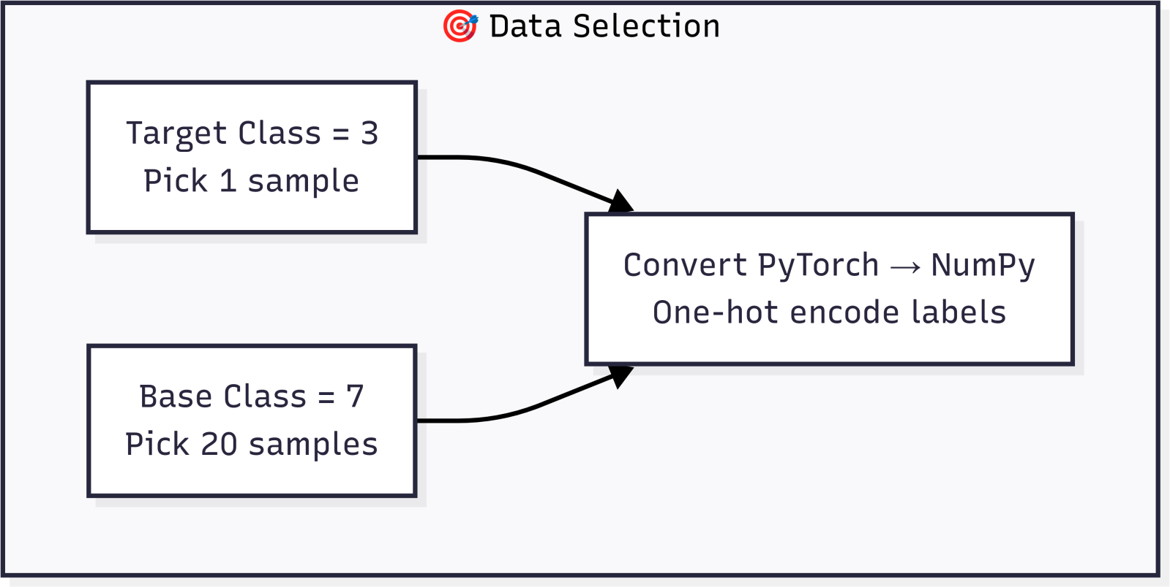

Slide 19
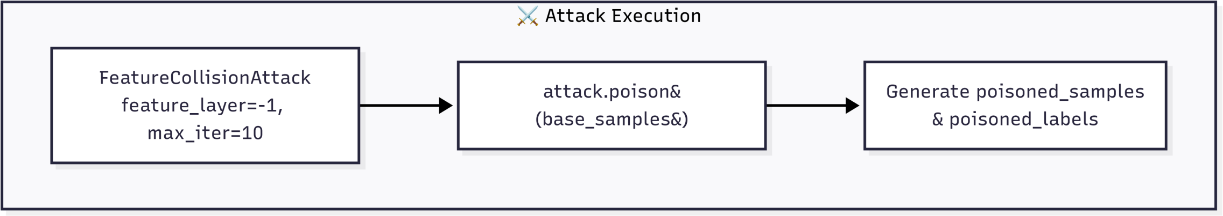
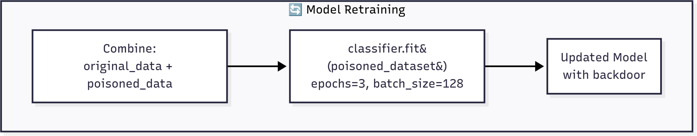
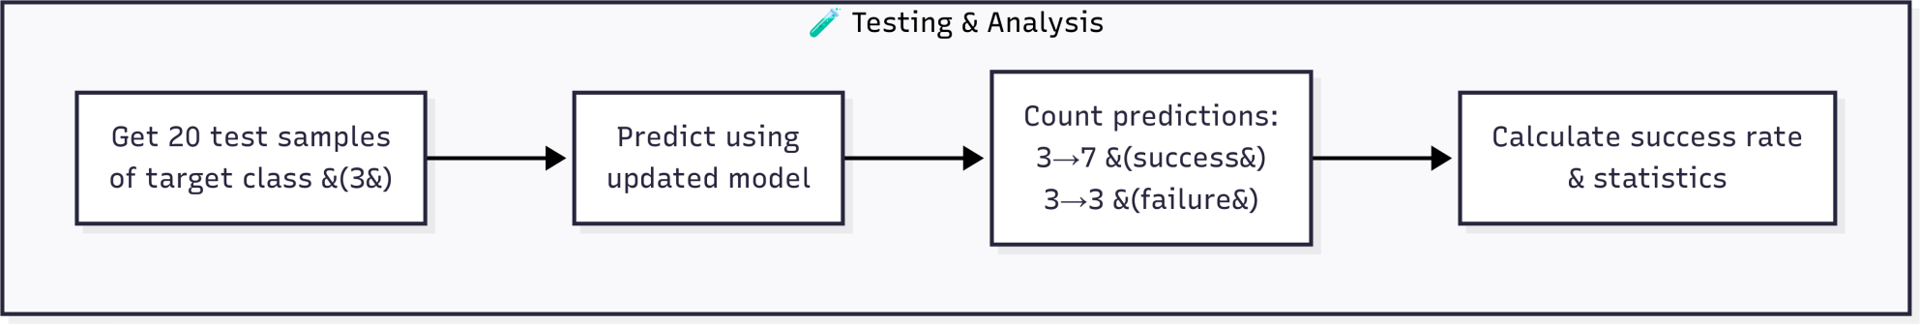

Slide 20
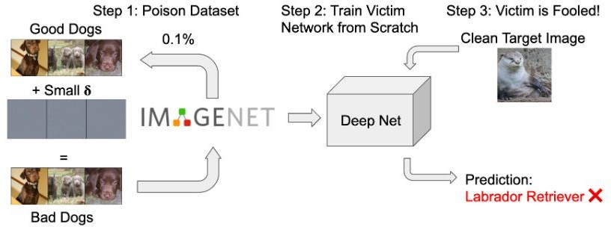
Gradient Matching or witche’s Brew
21

Slide 21
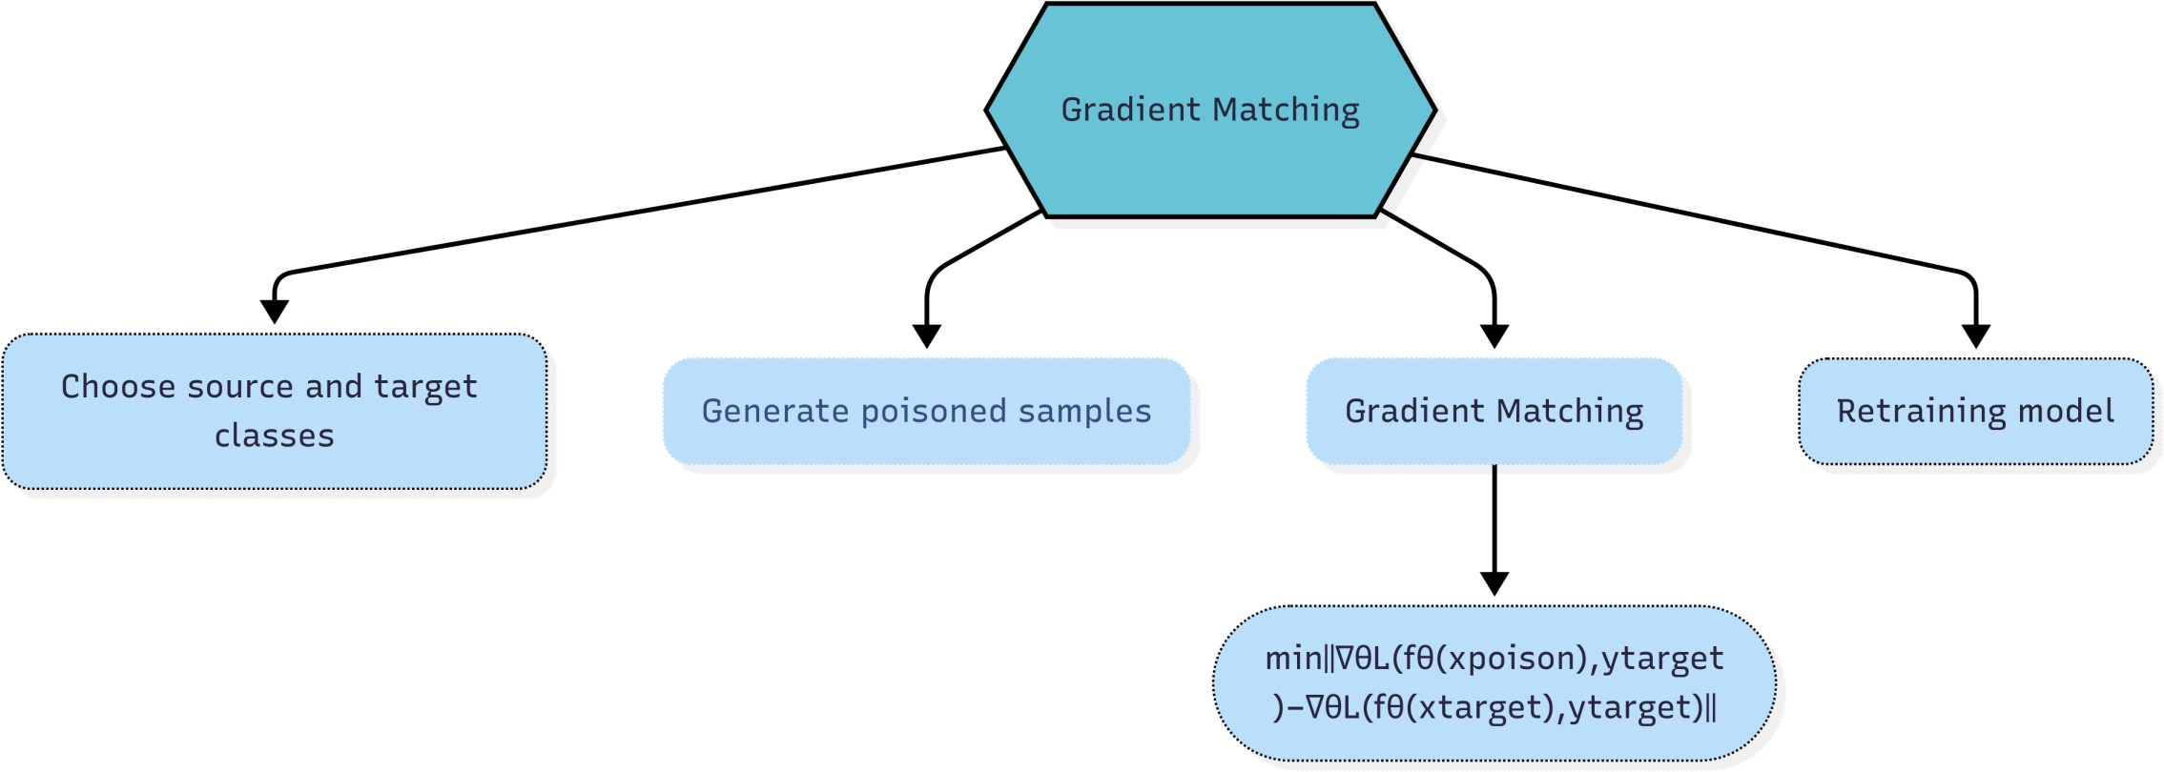

Slide 22
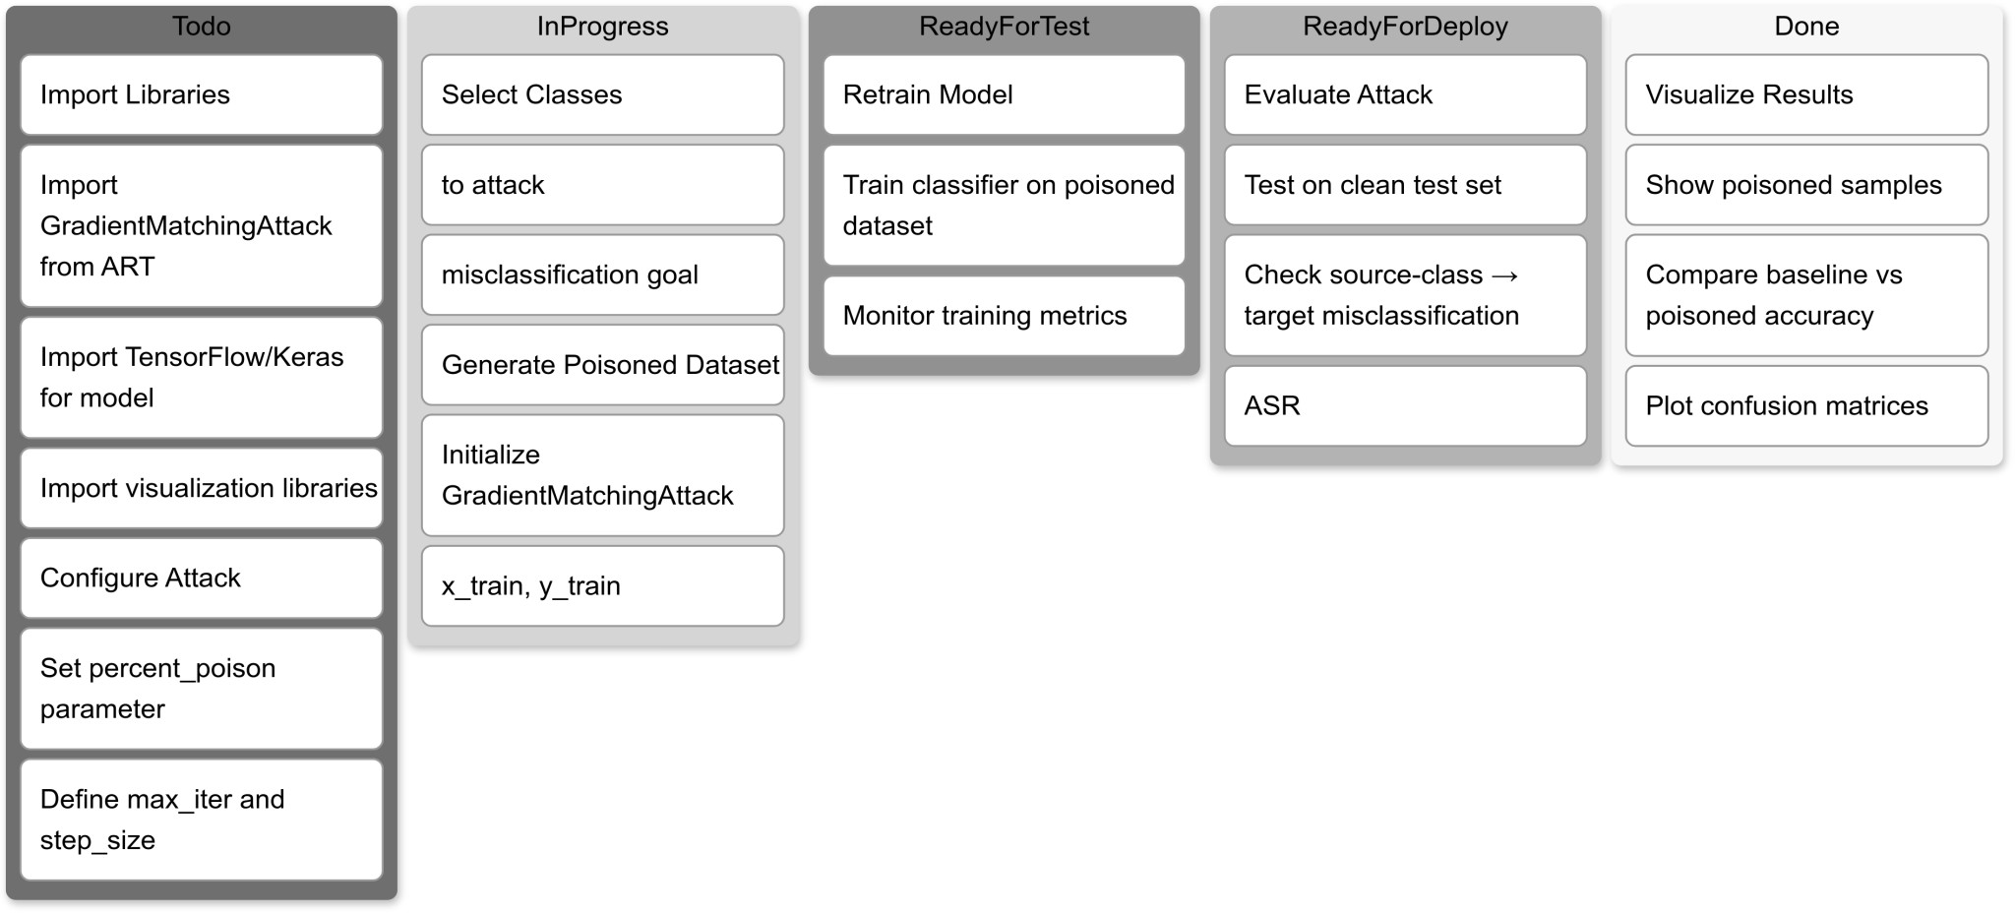

Slide 23

Explore Poisoning Attacks
.
A
we just want the AI to be wrong!!!
Taxonomy
Target attack
B
C
.
.
Untarget ATTAck
D

Slide 24
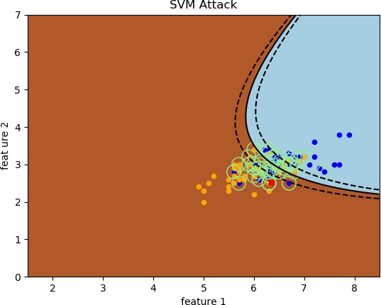
Poisoning SVM
25

Slide 25
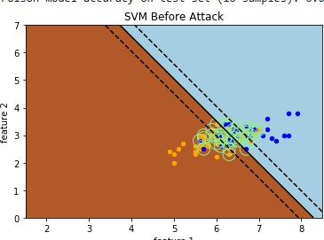
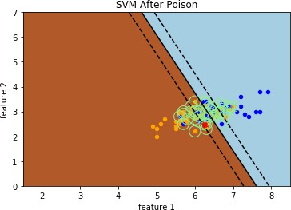

Slide 26
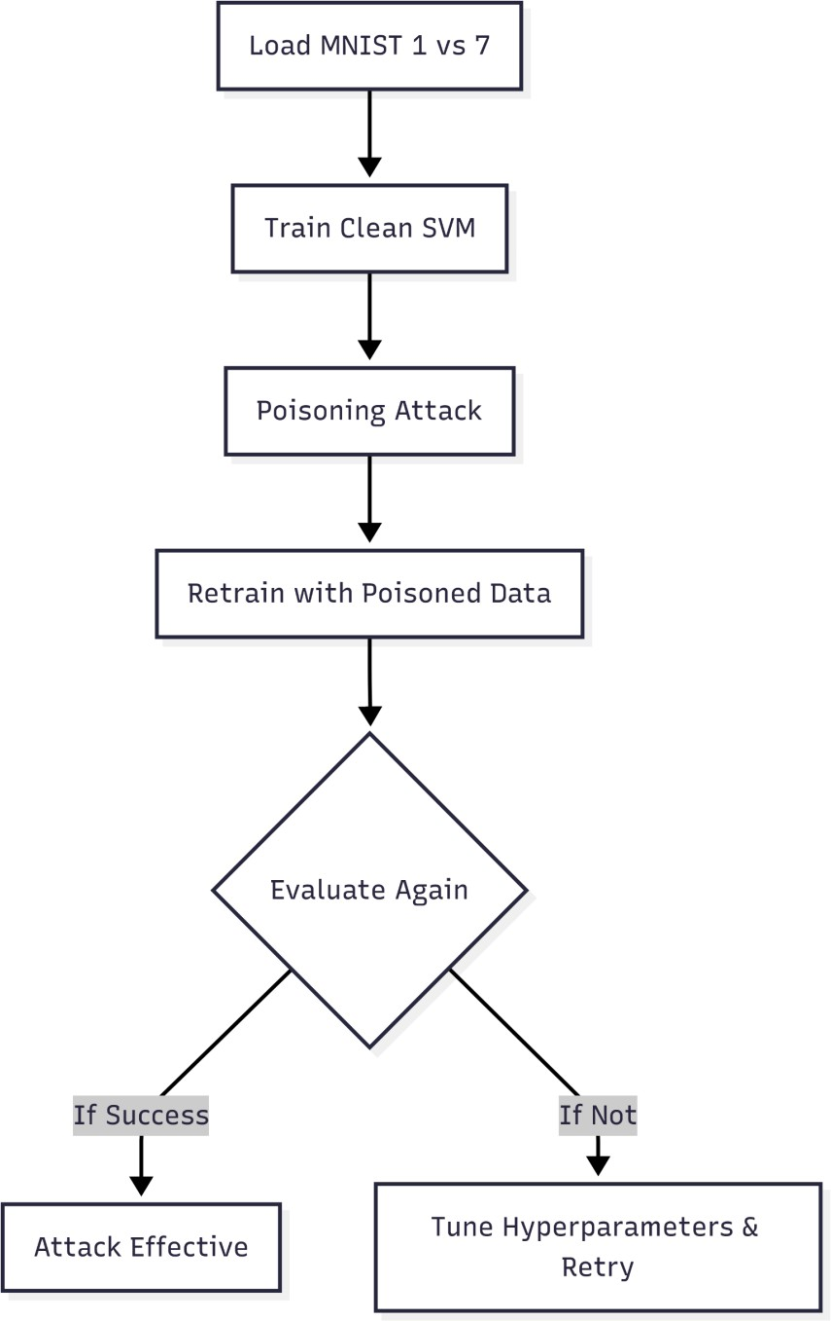

Slide 27

Explore Poisonning Attacks
.
A
Let’s See ALL
ATTACKS
Taxonomy
Target attack
B
C
.
.
Untarget ATTAck
D
Demo Live
E

Slide 28
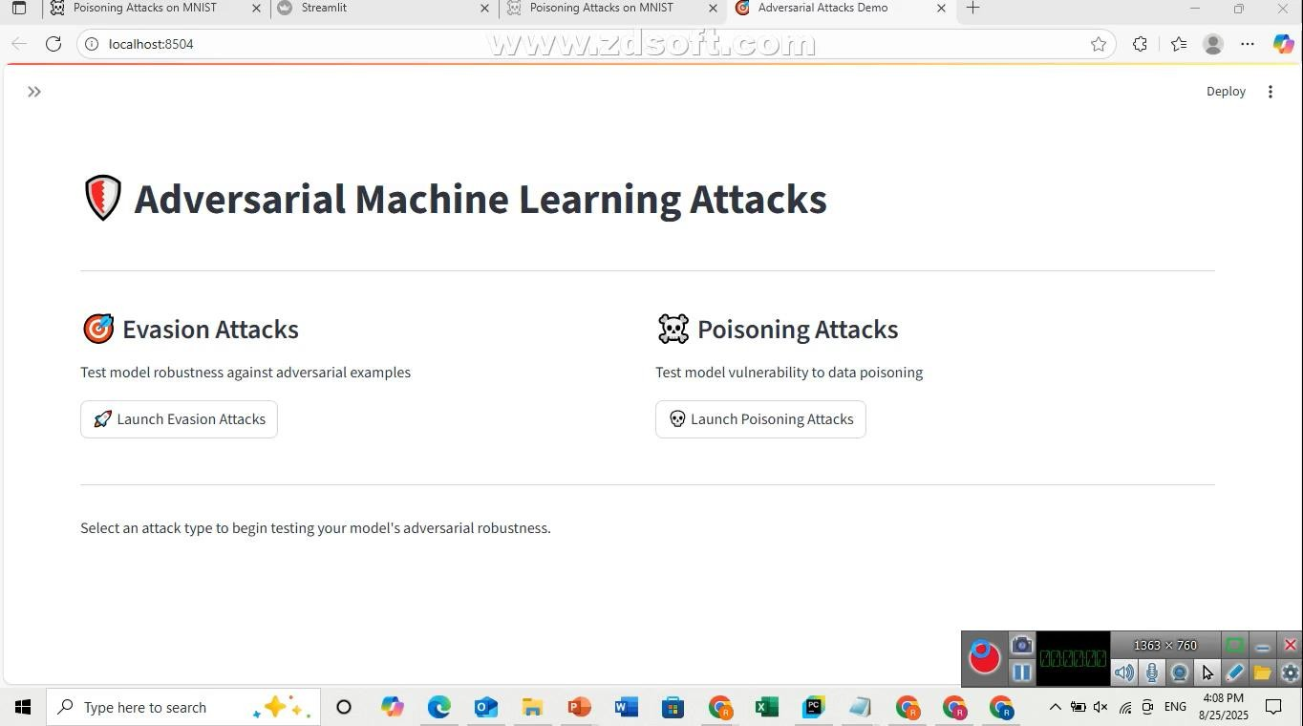
29

Slide 29

30

